Slide 1

DEPARMENT OF COMPUTER SCIENCE & ENGINEERING
Presentation control using Hand Gestures: A vision based approach
Batch : A-18
K Sai Teja 201191101022
B Matthew Mineeth 201191101029
Kishan Kumar Parida 201191101025
Project Guide:
Asst. Prof. Mrs O. Vasantha Kumari
(dept of CSE)

Slide 2
01
Abstract
Introduces a system using hand gesture recognition for intuitive slide control and additional functionalities.
Employs real-time image processing and machine learning for accurate gesture detection and interpretation.
Eliminates physical controls, allowing presenters to move freely and leverage natural body language for a more engaging experience.
Offers intuitive control compared to traditional methods, leading to smoother and more engaging presentations.
Explores expanding gesture control for richer interactions and potentially controlling computer systems beyond presentations.

Slide 3
02
Overview of the proposed project:
Real-Time Tracking
Gesture Recognition
Execution of gestures
The vision-based approach involves real-time tracking of hand movements, enabling precise control and interaction with presentation content.
It uses advanced python modules to interpret specific gestures, ensuring accurate and seamless control of presentation elements.
This approach seamlessly executes the command related to the identified gesture, enhancing user experience and enabling dynamic content manipulation.

Slide 4
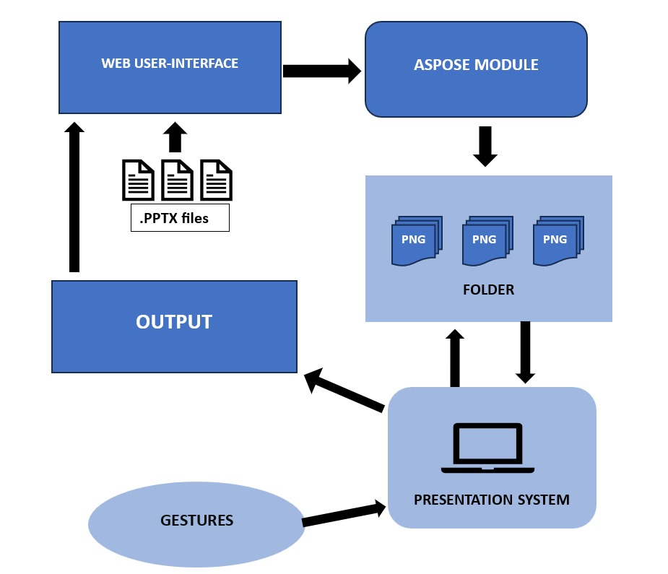
Architecture
03

Slide 5
05
How Hand Gestures Are Detected and Recognized
1
Real Time Tracking
2
Pattern Recognition
3
Machine Learning
Specialized camera sensors capture real time information information, enabling accurate detection of hand gestures in various lighting conditions.
Advanced pattern recognition Module identify unique hand patterns, enabling precise and reliable recognition of user inputs.
Inbuilt Machine learning techniques from mediapipe library enable the system to adapt and recognize a wide range of hand gestures over time, enhancing versatility.

Slide 6
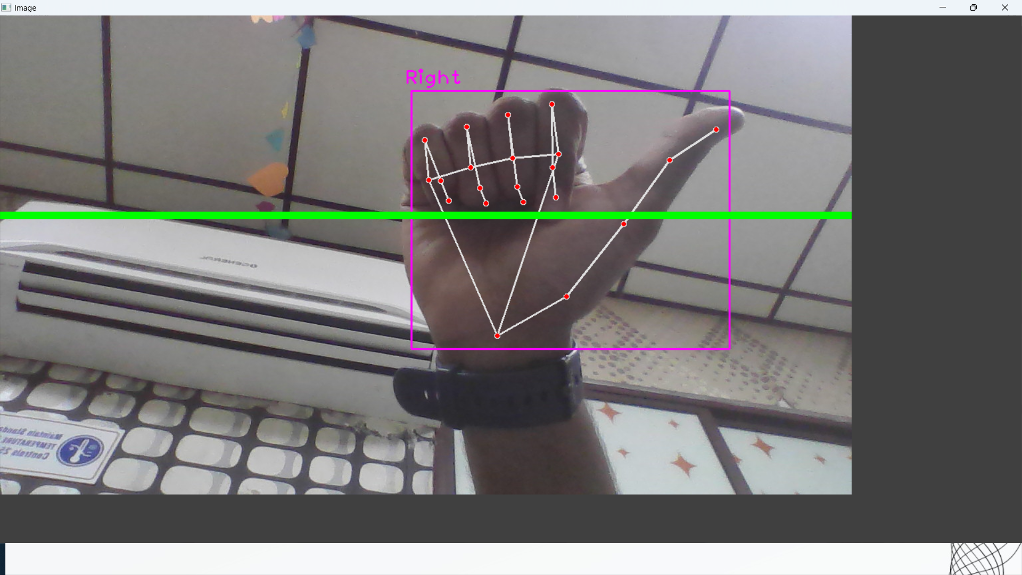
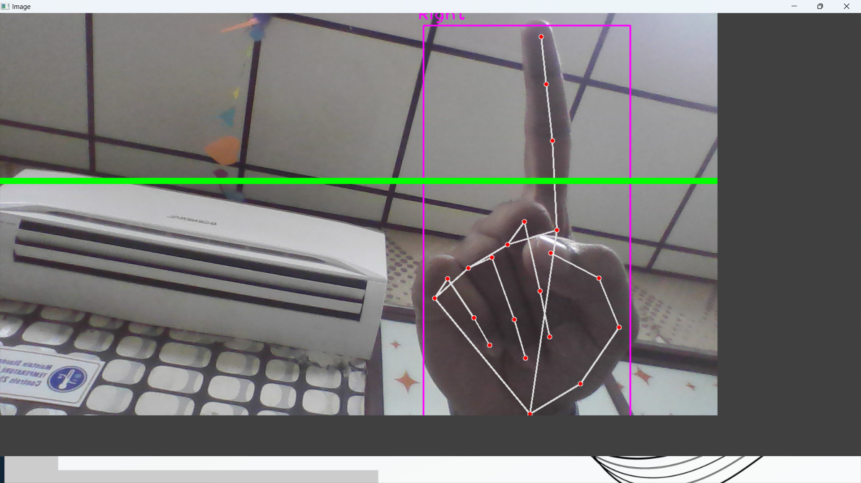
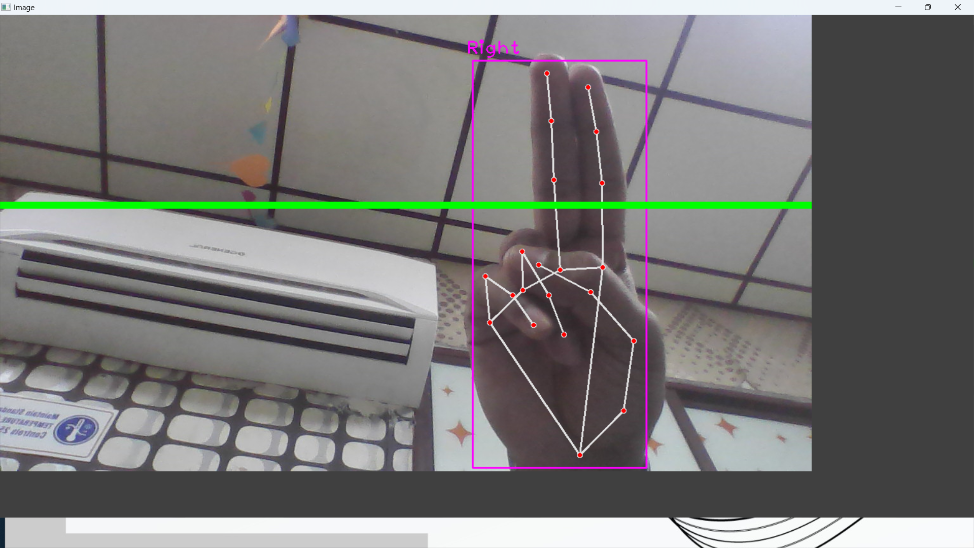
Gestures implemented in the proposed system
04
Gesture for changing slides
Gesture for drawing annotations
Gesture for using pointer

Slide 7


06
Training the System to Recognize Specific Gestures
Modules Used :
CVZONE’ S HAND TRACKING MODULE
MEDIAPIPE
ASPOSE.SLIDES
Model Development
Utilizing machine learning models to create robust recognition systems that accurately interpret specific gestures.

Slide 8
07
Challenges and Limitations of Vision-Based Approach
Lighting Variability
Environmental Interference
Variations in lighting conditions can impact the accuracy of gesture recognition and require robust calibration.
Distractions and environmental elements may interfere with precise gesture detection and affect system performance.

Slide 9
08
Benefits of Using Hand Gestures for Presentation Control
Efficiency
Engagement
Streamlined control and dynamic interaction with content, enhancing overall presentation delivery.
Increased audience engagement through interactive and visually captivating gesture-based control.

Slide 10
09
Hand Gestures Used in Presentation Control Project
Swipe left with thumb
Move to Previous Slide
Swipe right with little finger
Move to Next Slide
Two fingers
Pointer
Single fingers
Marker

Slide 11
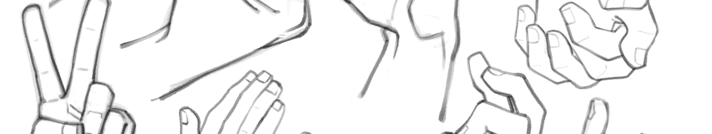
Conclusion and Key Takeaways
10
Interactive Experience
Technological Advancements
Human-Centric Approach
Utilizing hand gestures transforms presentations into interactive experiences, fostering a deeper connection with audiences.
The continuous evolution of vision-based technologies opens new frontiers for gesture-based presentation control.
Embracing natural gestures aligns with the human-centric trend in technology, enhancing user interaction and accessibility.

